Slide 1
PERSONA

Slide 2
Personas are fictional characters, which you create based upon your research to represent the different user types that might use your service, product, site, or brand in a similar way.
Creating personas will help you understand your users’ needs,
experiences, behaviors and goals.
Creating personas can help you step out of yourself. It can
help you recognize that different people have different needs and expectations, and it can also help you identify with the user you’re designing for.
Personas make the design task at hand less complex, they guide your ideation processes, and they can help you to achieve the goal of creating a good user experience for your target user group.

Slide 3
Personas do not describe real people, but you compose your personas based on actual data
collected from multiple individuals. Personas add the human touch to what would largely remain
cold facts in your research.
Creating persona profiles of typical or atypical (extreme) users will help
you understand patterns in your research, which synthesizes the types of people you seek to
design for.
Personas are also known as model characters or composite characters.

Slide 4
Personas in Design Thinking
In the design thinking process, designers will often start creating personas during the second
phase, the Define phase.
In the Define phase, Design Thinkers synthesize their research and findings from the very first phase, the Empathise phase.
Using personas is just one method, among others, that can help designers move on to the third phase, the Ideation phase. The personas will be used as a guide for ideation sessions such as Brainstorm, Worst Possible Idea and SCAMPER.

Slide 5
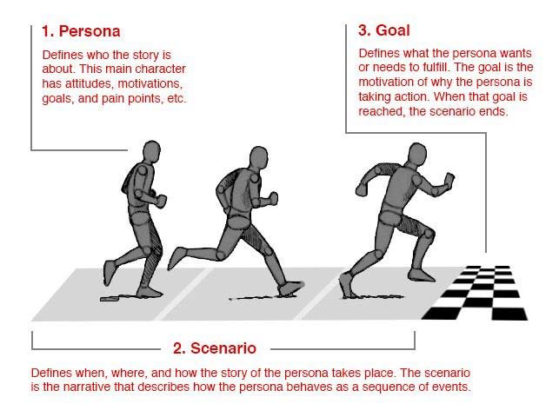
Four Different Types of Personas: Goal‐directed Personas

Slide 6
2. Role‐Based Personas
The role‐based perspective is also goal‐directed, and it also focuses on behavior.
The personas of the role‐based perspectives are massively data‐driven and incorporate data from both qualitative and quantitative sources.
The role‐based perspective focuses on the user’s role in the organization. In some cases, our designs need to reflect upon the part that our users play in their organizations or wider lives.
An examination of the roles that our users typically play in real life can help inform better product design decisions.

Slide 7
Where will the product be used?
What’s this role’s purpose?
What business objectives are required of this role?
Who else is impacted by the duties of this role?
What functions are served by this role?

Slide 8
Engaging Personas
“The engaging perspective is rooted in the ability of stories to produce involvement and insight.
Through an understanding of characters and stories, it is possible to create a vivid and realistic description of fictitious people.
The purpose of the engaging perspective is to move from designers seeing the user as a stereotype with whom they are unable to identify and whose life they cannot envision, to designers actively involving themselves in the lives of the personas.
The other persona perspectives are criticized for causing a risk of stereotypical descriptions by not looking at the whole person, but instead focusing only on behavior.”
– Lene Nielsen
Engaging personas can incorporate both goal and role‐directed personas,

Slide 9
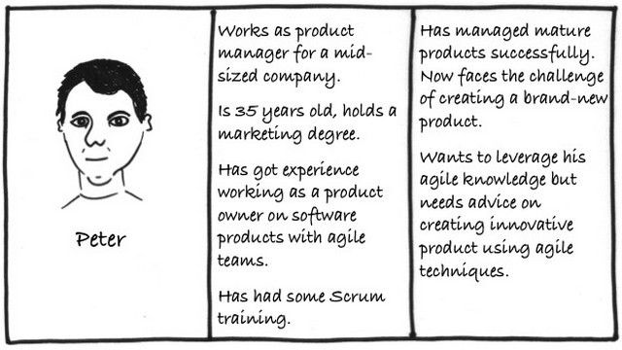

Slide 10
Fictional Personas
The fictional persona does not emerge from user research (unlike the other personas), but it emerges from the experience of the UX design team.
It requires the team to make assumptions based upon past interactions with the user base and products to deliver a
picture of what, perhaps, typical users look like.
There’s no doubt that these personas can be deeply flawed (and there are endless debates on just how flawed). You may be able to use them as an initial sketch of user needs.
They allow for early involvement with your users in the UX design
process, but they should not, of course, be trusted as a guide for your development of products or services.

Slide 11
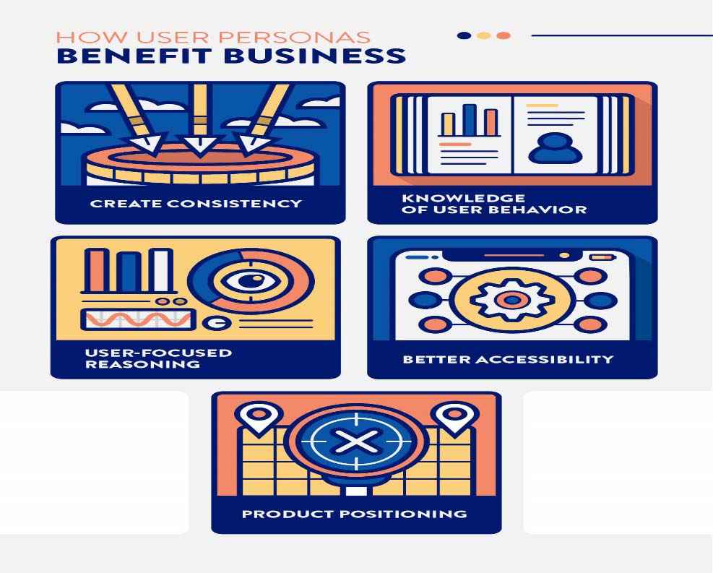

Slide 12
How Do You Make a User Persona?
Here are some basic features to include in every user persona:
• Name:
• Photo:
• Personal motto:
• Bio:
• Demographics:
• Personality traits:
• Motivations:
• Goals and frustrations:
• Preferred brands and influences:

Slide 13
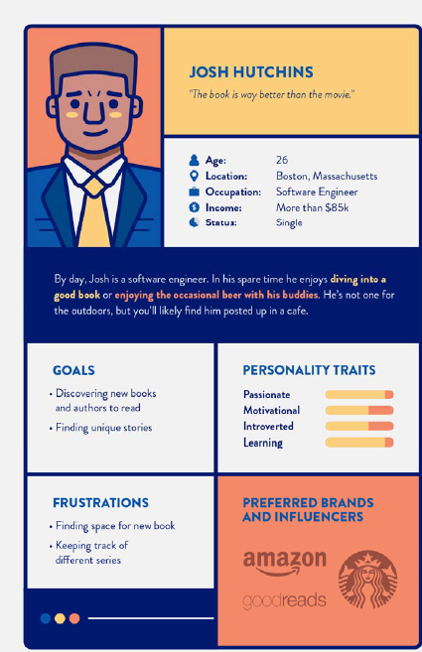

Slide 14
Thank You

